Slide 1

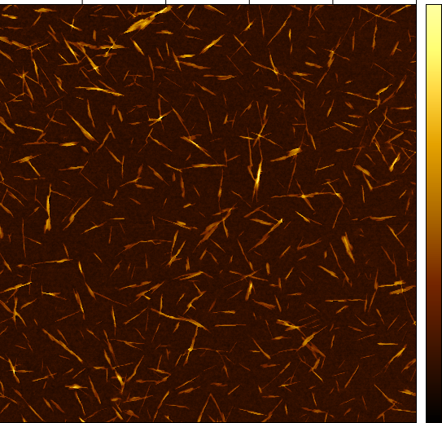
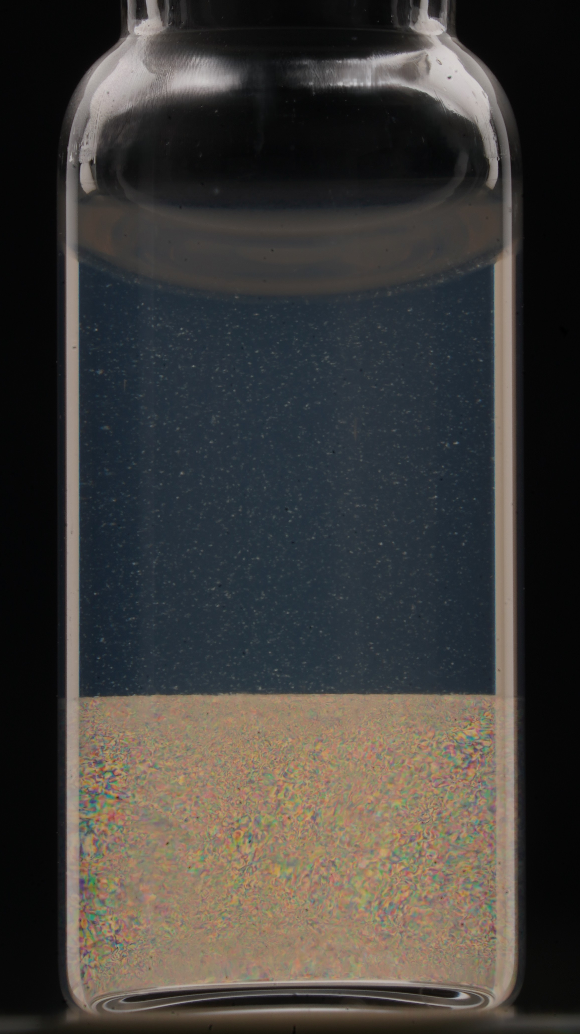

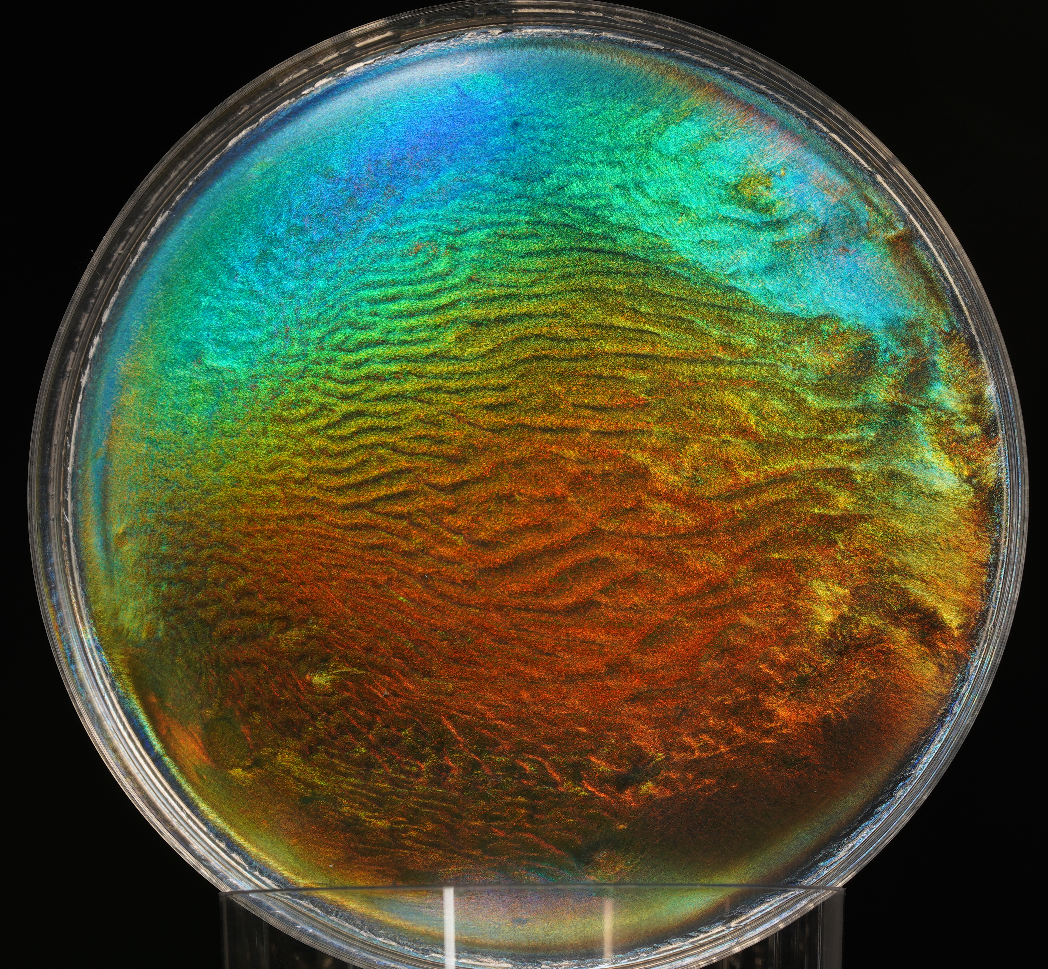
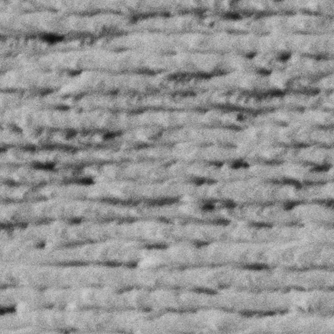

Cellulose nanocrystals: from colloidal systems to functional structures
Buse Tatli
PhD student
15.0 nm
500 nm
-15.0 nm
Hybrid CNC materials with additives and/or “residual” compounds
Influence of sugars, and “residual” materials such as lignin, hemicelluloses on fundamental properties including self-assembly, rheology, optical and mechanical properties.
Tailored hybrid CNC materials depending on the application (e.g., strain induced color-shifting CNC films in smart food packaging)
CNC suspension
20 µm
CNC film
500 nm

